Slide 1

Project Gutenberg
Han Zhang 3075097260
Chenghao Mou 5704178645

Slide 2

Project Gutenberg
Content
Recap
Meta Data Extraction*
Index*
Storage*
Facet search
Keyword search
Download

Slide 3
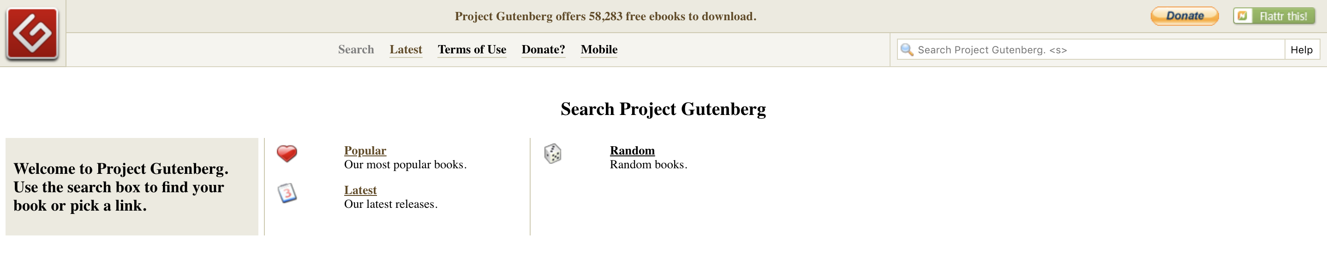
1 Recap
Project Gutenberg offers over 57,000 free eBooks. You will find the world's great literature here, with focus on older works for which copyright has expired. Thousands of volunteers digitized and diligently proofread the eBooks, for enjoyment and education.
“
Official website search page

Slide 4

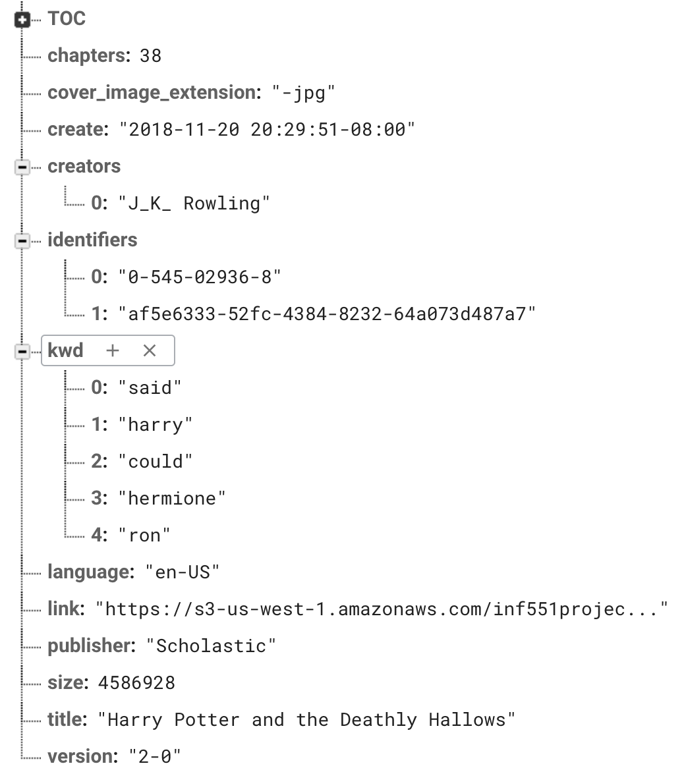
2 Meta data Extraction
Dependencies
1. Epub meta 2. ebooklib

Slide 5
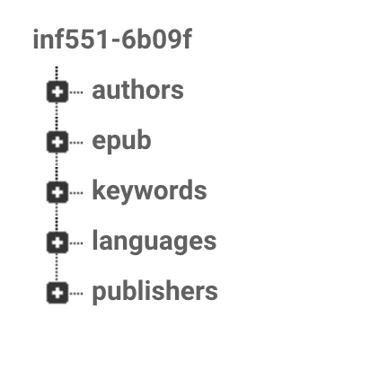
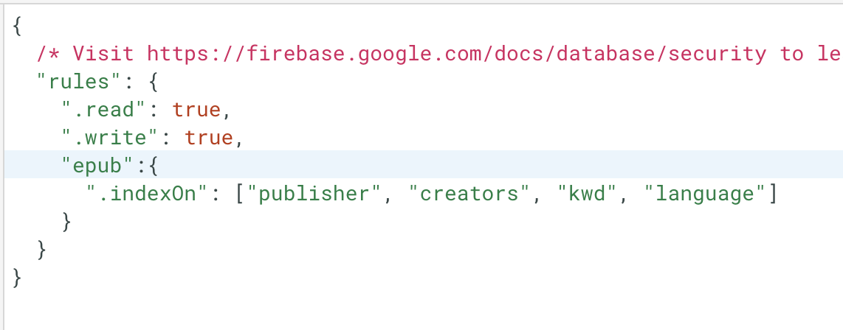
3 index and inverse index

Slide 6

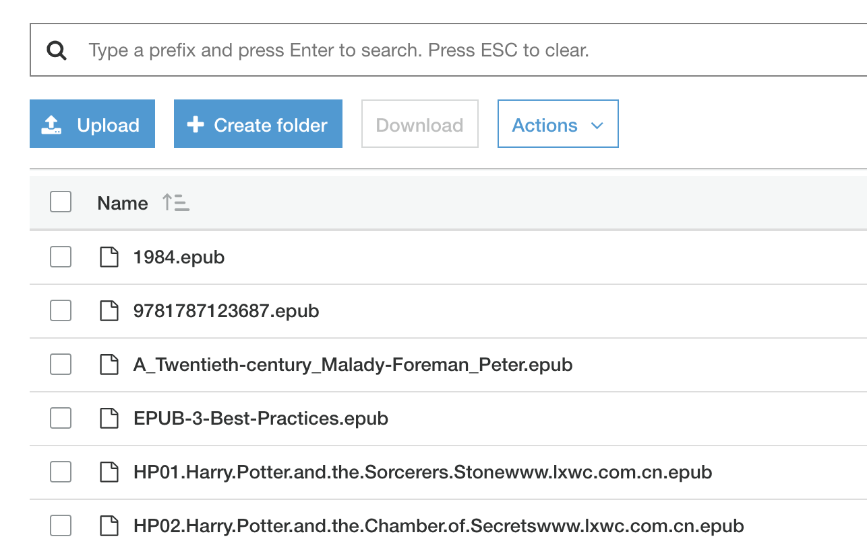
4 upload and storage
Real-time upload the firebase synchronization
Keywords and download link appended to its metadata

Slide 7

5 Facet search
Top 5 values are listed:
author/creator
Language
publisher
When multiple facets are selected, a union set of books are queried from firebase
Supports multi-file upload to S3 and firebase form the web client

Slide 8

6 keyword search
Supports multi-attribute keyword search:
Author
Publisher
Keyword
Book title
TOC display
Keyword display
Download from S3
Retro style and animation

Slide 9





* Architecture
jQuery & Bootstrap
AWS S3
Firebase
Python + Bottle
+ Ebooklib
+ Epub meta

Slide 10

Behold

